Slide 1
Differential Forms: A Basic Introduction
Irtaza Tanveer Ahmad (24100039)

Slide 2
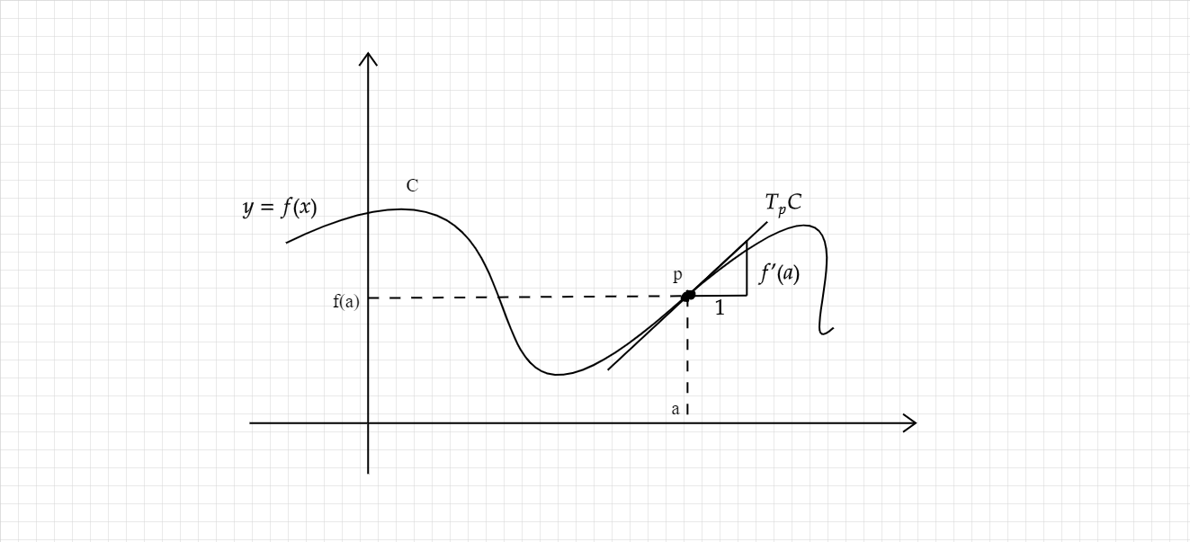
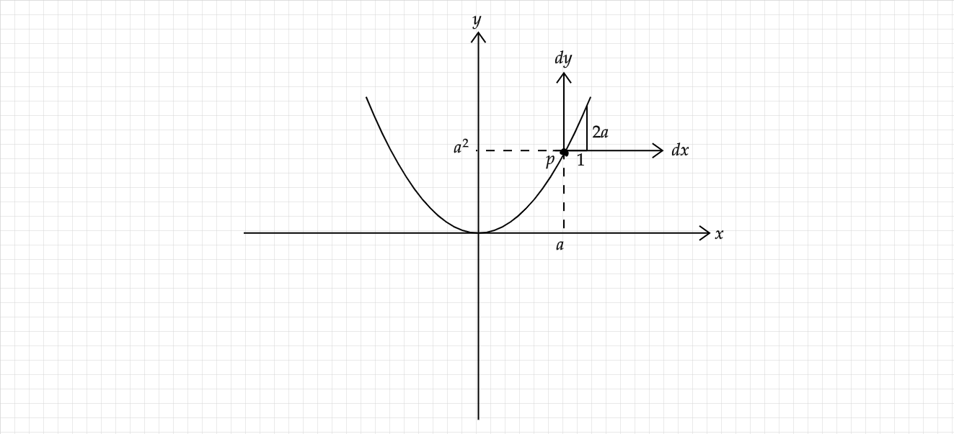
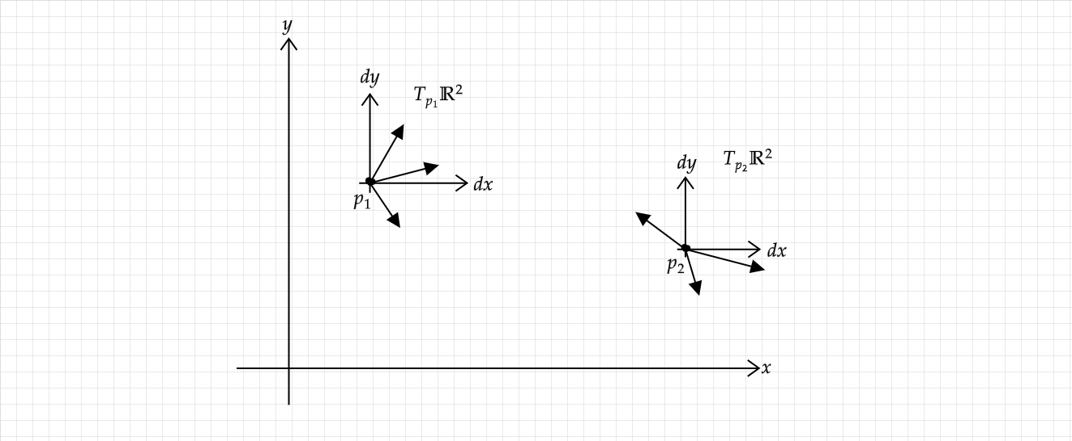
Introducing the Tangent Space

Slide 3


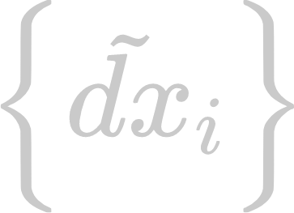
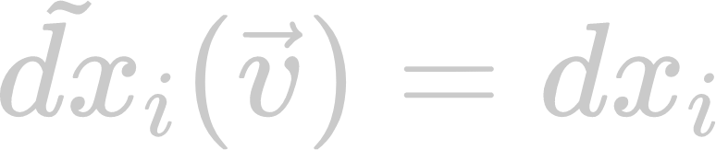
One-Forms on
A one-form is a linear function that acts on a vector in the tangent space to produce a number
Linearity implies that evaluating a one-form on a vector is the same as projecting onto each coordinate axis, scaling by a constant, and adding all of the results
Elementary one-forms:

Slide 4

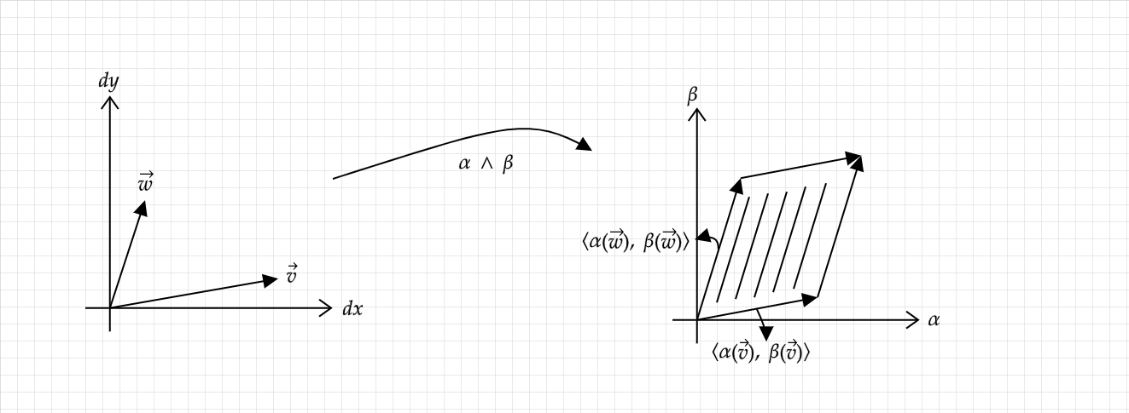
Two-Forms
Wedge product: allows us to “multiply” two one-forms to obtain a two-form i.e. a function that takes in two vectors from the tangent space to produce a number
If we demand that this two-form is a linear function with some meaningful geometric interpretation, we find that

Slide 5
Properties of the Wedge Product
Skew-symmetry
Bilinearity
Distributivity over addition

Slide 6



Generalisation: m-Forms on
Bilinearity → multilinearity
Skew symmetry
Recipe: take the wedge product of m one-forms → determinant of an m-dimensional matrix
Basis for the space of m-forms:
Useful shorthand:
Basis decomposition of an m-form:

Slide 7

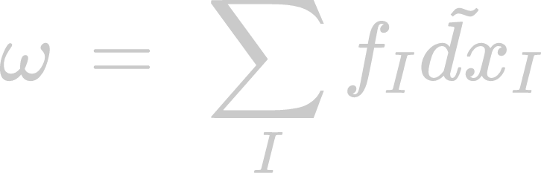
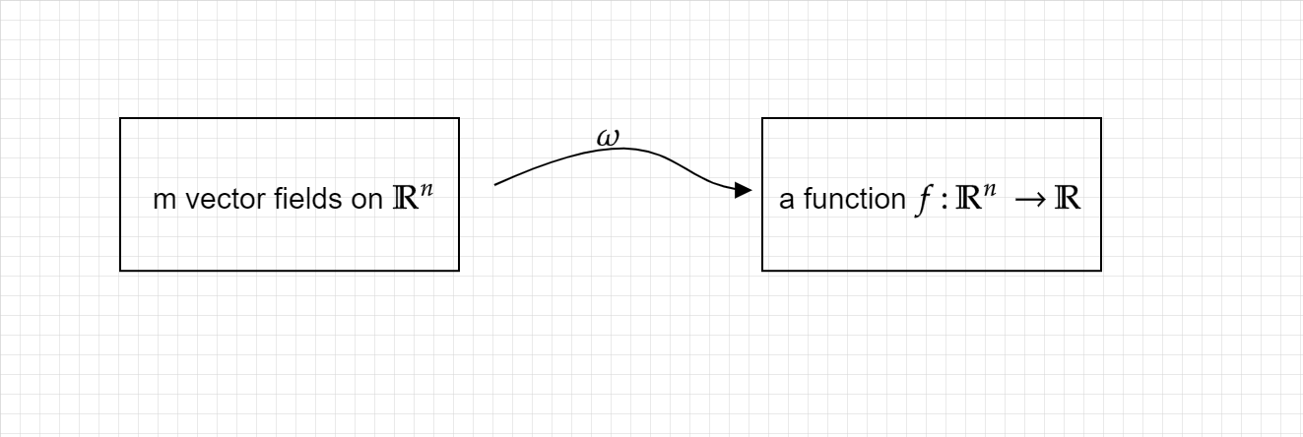
Differential m-Forms on
Idea: make the coefficients of an m-form from simple numbers to functions
To fully evaluate a differential form, we then need a base point and vectors that lives in the tangent space of that point
Further generalisation: let the point be arbitrary, and let the vectors be vector fields
Evaluating a differential form then gives us a function

Slide 8
Where do we go from here?
Integration of differential forms → generalisation of integration of functions
Allows us to recast u-substitution and the change of variables formula in terms of differential forms
Exterior derivative → get a differential (m+1)-form from an m-form
Hodge Operator → mapping from the space of m-forms to the space of (n-m)-forms
Defining the exterior derivative and the Hodge operator allows us to rewrite the gradient, divergence and curl from vector calculus
“Upgrade” the Hodge Operator using an inner product
Minkowski inner product → allows us to rewrite Maxwell’s Equations in terms of differential forms
Connection to tensors
Differential m-form is just a (0,m) totally antisymmetric tensor

Slide 9
Thank you ^_^

